Slide 1
DeepDogPerson multi-object detection: Deep learning for identification of people, dogs, and hot dogs in common images
Akshay K. Rao
MS Mechanical Engineering
April 14, 2021
Significant code used for this assignment was adopted from Prof. Avi Kak’s modules: DLStudio and RegionProposalGenerator

Slide 2
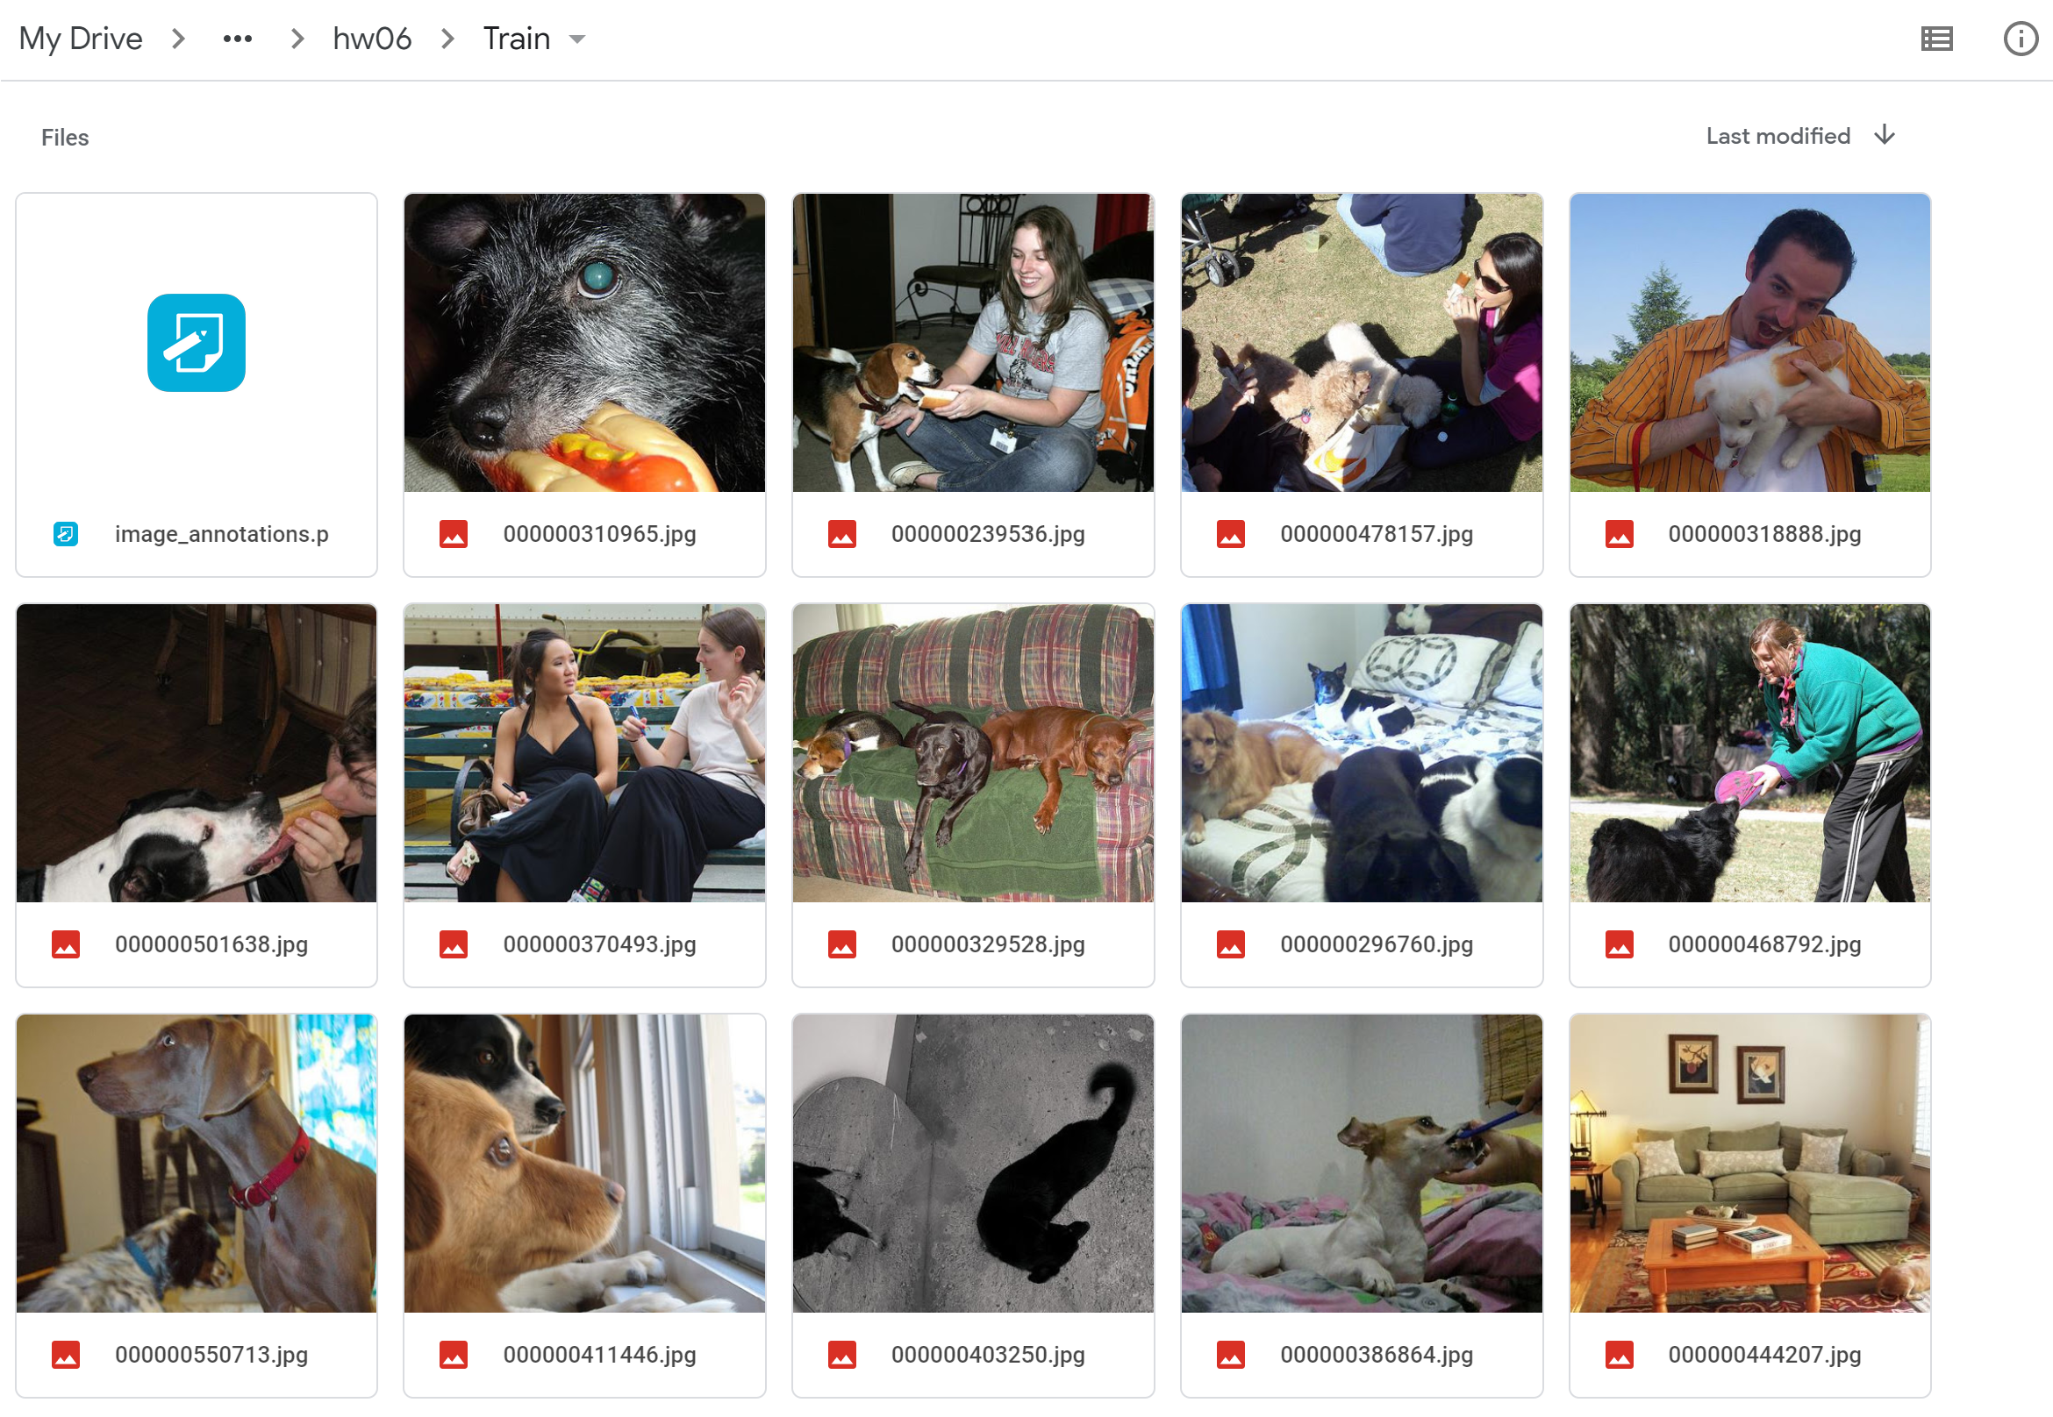
Curating the dataset from Microsoft COCO
Class subset: [“Person”, “Dog”, “Hot Dog”]
Dataset subset: At least 2, but at most 5 objects per image
Images with less than 2 objects are not downloaded
Data loader sorts objects by area and considers the largest 5
Filename: ‘(COCOimageID).jpg’
‘image_annotations.p’ : shortcut dictionary to the dataset indexed by filename
Training: 1153 images
Validation: 116 images

Slide 3
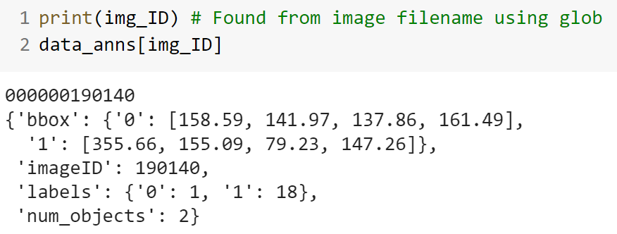
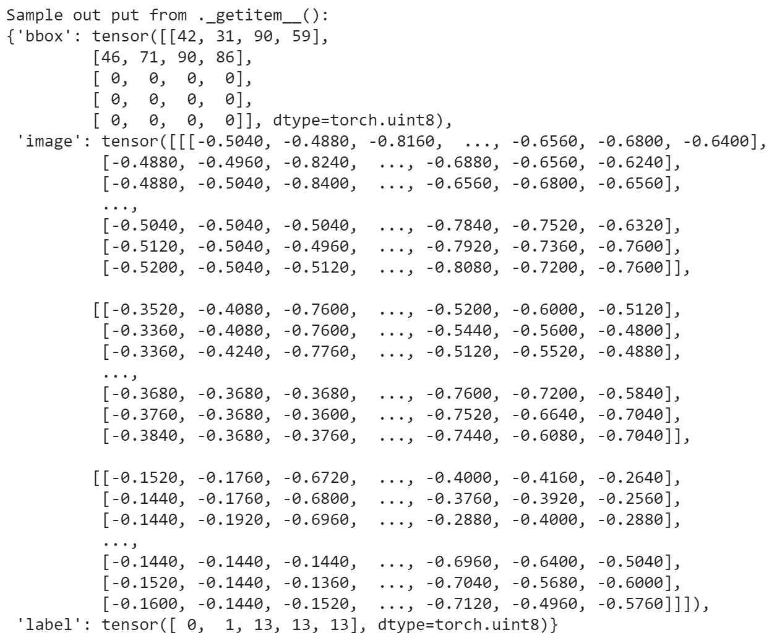
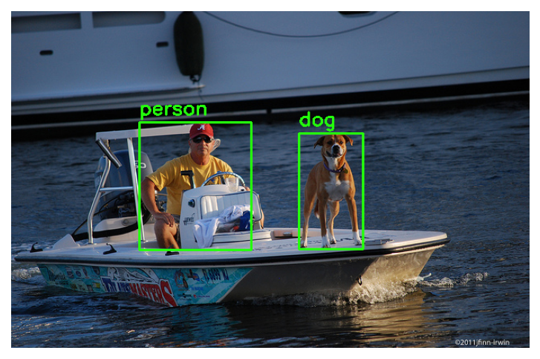
Organization with the Dataloader
Dataset Annotations
__getitem__()
Dictionary file indexed by the COCO image ID, containing the bounding box and label of each object
(5,4) tensor
Bounding box for each object
COCO labels are indexed
to class subset labels in training
Reshaped
Image
tensor
Sample Image (from validation set)
(5,1) tensor
Label for each object
13 indicates no object

Slide 4
Yolo training logic
Conditions used in training
Batch size = 64
Initial image size = 128 x 128
Yolo interval = 16
Max objects per image = 5
Anchor boxes = 1/1, 1/3, 3/1, 1/5, 5/1
Classes = [‘person’, ‘dog’, ‘hot dog’]
Yolo tensor loop:
Index each object (0 – max objects) and each image (0 – batch size)
Get batch of images from dataloader: __getitem__()
Locate yolo cell for the object center
OneHot encode labels
For object AR:
yolovector[0] = 1
Pass image to net()
Convert bounding box groundtruth in terms of yolo cell
Predict a flattened yolo tensor of shape (batch, yolo_cells*aboxes*(5+num_classes))
Compute the appropriate aspect ratio of groundtruth image
Assemble yolo vector for each object in the batch
Initialize yolo tensor of zeros:
(batch, yolo_cells, aboxes, 5+num_classes)
Place yolo vectors in the yolo tensor
*nn.MSEloss(prediction, yolo tensor)
Note: Since a yolo vector gets placed in only of the AR dimensions, the groundtruth yolo tensor is sparse
*Future iterations may implement Jaccard distance or custom YOLO loss functions for better generalizability

Slide 5
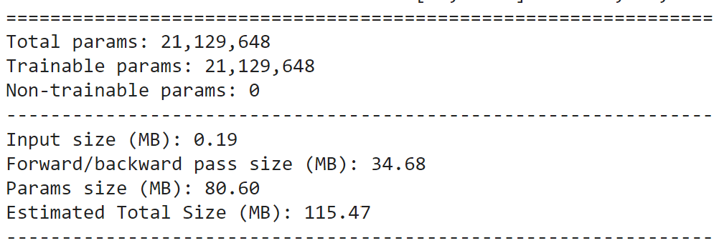
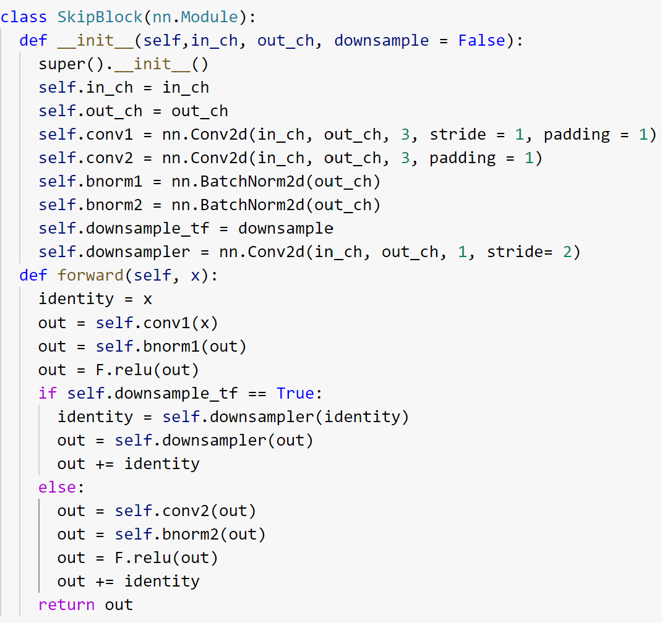
Building the network
Input image tensor: (3, 128, 128)
Network layers:
64 convolutional with 3x3 kernel and 64 channels
2 fully connected with 3000 neurons per hidden layer
ReLU used for all activation
Output yolo tensor: (64, 8*8*5*8)
Skip connections and batch normalization are used for each convolutional layer

Slide 6
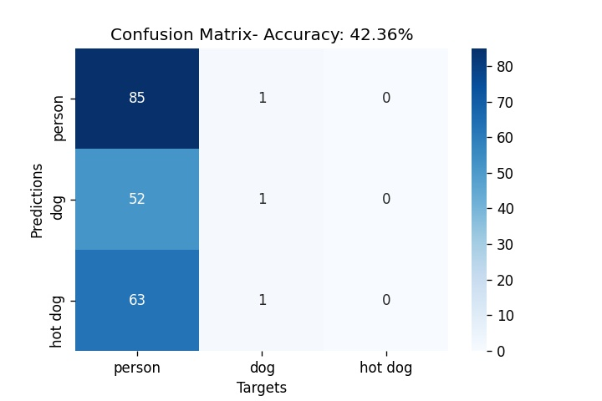
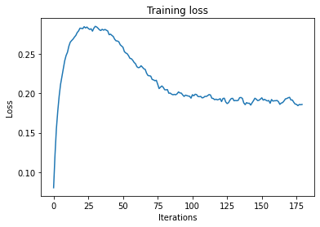
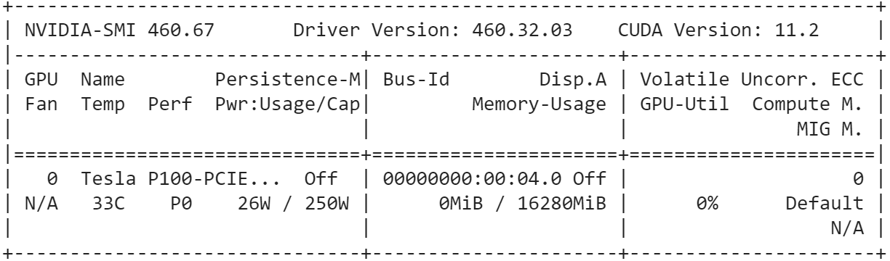
Results
*Validation Loss: 0.254
Training Loss
Targets
Relevant Hyperparameters
Learning Rate: 0.005
SGD+ Momentum: 0.5
Training Epochs: 30
Predictions
Training hardware:
*Validation used the weights from the training step and averaged loss over 1 epoch

Slide 7
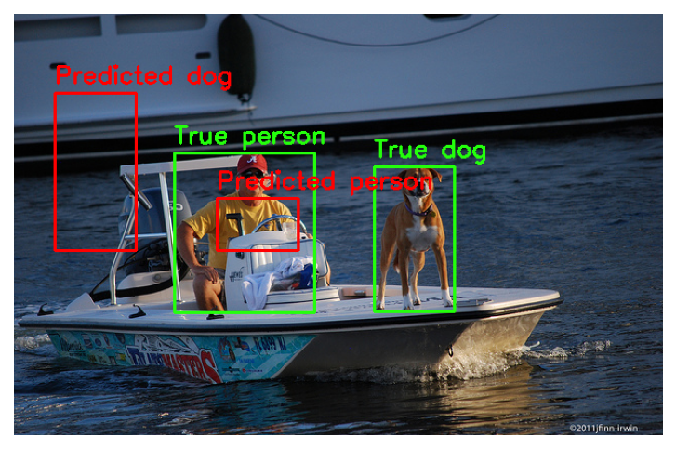
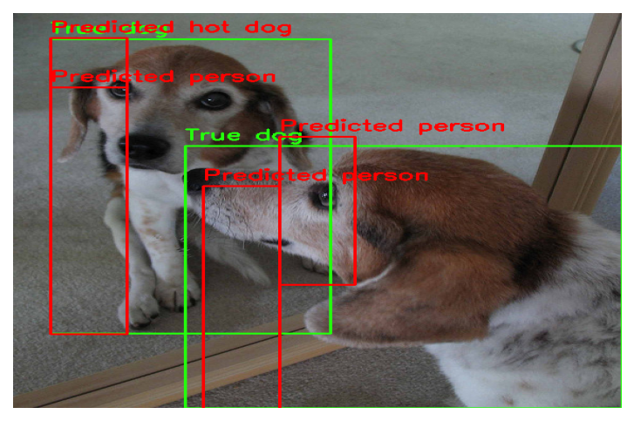
Bounding box predictions
This post-processing considered predictions above a threshold value (0.75) for the first index of each yolo vector
Validation set
Training set
This may suggest that the network was not expressive enough and underfit the training data. Similarly another issue could be the small amount of images used for this study.

Slide 8
Conclusions
The dataset was likely heavily biased to including more images of people
From the training loss curve and predictions, the network likely underfit the training data and therefore performed poorly on both sets.
Future improvements may include:
Splitting the network to do regression and classification in specialized networks (hw5)
Curating a larger dataset that is more equally distributed along classes
Decreasing the yolo interval to allow for smaller feature detection
Implementing custom yolo loss
Using an optimizer to tune hyperparameters (opposed to naïve grid search)

